Slide 1
Quality Engineering Community of Practice
QE Tools & Frameworks : US Segment
Apr,2021
Join the conversations, ask questions and learn collaboratively on our Yammer Site!

Slide 2




























Quality Engineering Tool-Stack : US Segment
EXISTING JOHN HANCOCK TOOLS & FRAMEWORKS
TEST AUTOMATION
BUILD & SCM
BDD & TDD
CI & CONTAINERS
TEST MANAGEMENT
API TESTING
MOBILE TESTING
DB TESTING & TDM
NFT
QE BOTS
*Cognizant managed
In addition to the standardized tool-stack, there are 80+ bottom-up tools & accelerators for project specific usage (PDF testing, Link scanning etc.)
KEY HIGHLIGHTS:
Focus on Open Source/Freeware Adoption to minimize License Cost
Quarterly Tooling & Licensing Refresh for Infra. Cost Opt.
Framework Standardization for Selenium/TestNG
Solution for Single User Client Side Performance Testing

Slide 3
Standardization of Selenium Automation Framework : Overview
Ease of Test Script Maintenance with Object repository in Page Object Model (POM) pattern
Configuration without touching the code – using Test Configuration manager in XML format with download configuration provision
Data Driven Iterative testing with Data Provider in CSV and XML formats
Intuitive & Detailed test execution logs using Extent report
Ability to trigger scripts from command prompt using Maven surefire and TestNG CLI
Offering Automated Compatibility checks with Driver manager for multiple browser and headless testing capability
Easy debugging and error identification with Log4J and Listener class implementation for console and file logging of errors and warnings
Optimized script issue led failures with Automatic Re-try execution based on config. file
Improved productivity led by re-usability – with Various UI action utilities for page synch, alters/frame switching, JS handling etc.
Readiness for DevOps &
Digital Tech-Stack
Getting the basics Right
KEY BENEFIT OFFERINGS:
Tools Cost Optimization (UFT licenses) leading to Expense Efficiency
Headless, Multi-threaded & Multi-Grid Execution – improving Sprint velocity
Increasing Build frequency with TeamCity based CI/CT Ready Automation
~10%-15% Higher Script design Productivity – leading to higher QA throughput
PIPELINE FEATURES: Database Connectivity | REST API Handling | Password Encryption/Decryption | Robot Class Integration

Slide 4

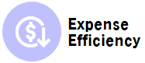
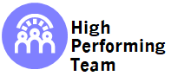


Single User Client Side Performance Testing : Web Analytics Doctor
AMBITION
“To be the most digital, customer centric, global company in our industry”
STRATEGY
Objectives Achieved by Web Analytics Doctor (WAD)
IMPROVED USER EXPERIENCE
OPTIMIZED COST OF DEFECT REMOVAL
CROSS-FUNCTIONAL QE TEAM
Client-side Performance insights aids in delivering great Customer Experience & improving NPS for Digital Storefronts
Performance testing executed in parallel with automated regression cycles – with Zero Addn. Time/Effort
Early identification and debugging of Performance bottlenecks helps in reducing Cost of Defects
Centralized Dashboard to Monitor the pages and offer insights
Ability to perform
Time-boxed Analysis & Comparative Study
Page Loading Time broken into Milestones for Easy Debugging on bottlenecks
Insights on loading time will help deliver great customer experience
BENEFITS DELIVERED
Great visualization of performance data. QA team did a good job of determining which use cases to use for My Dashboard to show the variables that influence the load times. - Michael L. Stephenson, Lead Solution Architect
I think it will be a big help in making sure our pages are running properly and help us deliver a great customer experience. - Alexander Tsoupas, LTC Storefront Product Owner
I think this tool is like a bunch of gorgeous furniture that has been put into a room…and now we need to design the space a little. I am a fan – Richard LaDue, Life Storefront Sr. PO
ACCOLADES

Slide 5






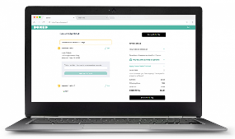
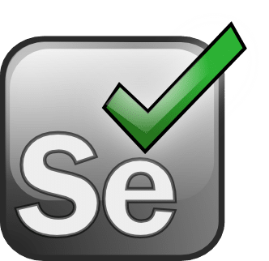


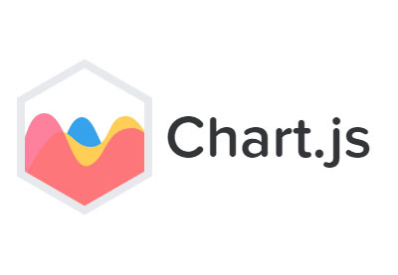
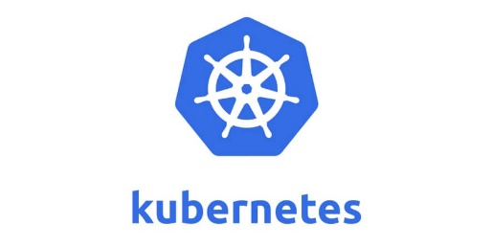
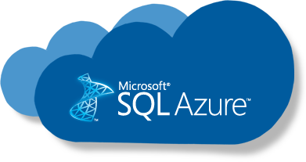

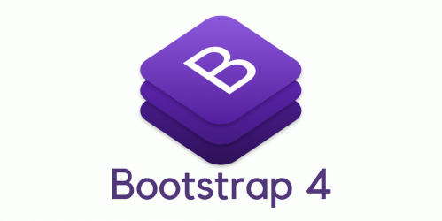


Solution Blue-Print : Architecture and Tech-Stack
4
Page load metrics get stored in Azure MI SQL
On-demand KPIs pull-up and comparison
Selenium based Traditional Automation Scripts – coupled with the Java utility
1
3
API posts data pertaining to Page Loading Times
6
Non-Functional Test Logs
Scripts get trigged for E2E Execution
5
Functional Test Logs
2
Application Under Test
Selenium Based Automation Script
USER INTERFACE AND REPORTING
DATABASE & HOSTING

Slide 6
THANK YOU

